Slide 1
08 | Rewind
James Chambers | @CanadianJames
Simon Timms | @stimms

Slide 2
Module Review
Applications on Azure: Putting All the Pieces Together
01 | Intro | 05 | Storing Data and Objects in Azure
02 | Exploring Application Architecture | 06 | ElasticSearch, Docker and YOU
03 | Working with Azure DNS Services | 07 | Scaling Your Application Under Load
04 | Executing Large Tasks in the Cloud | 08 | Rewind

Slide 3
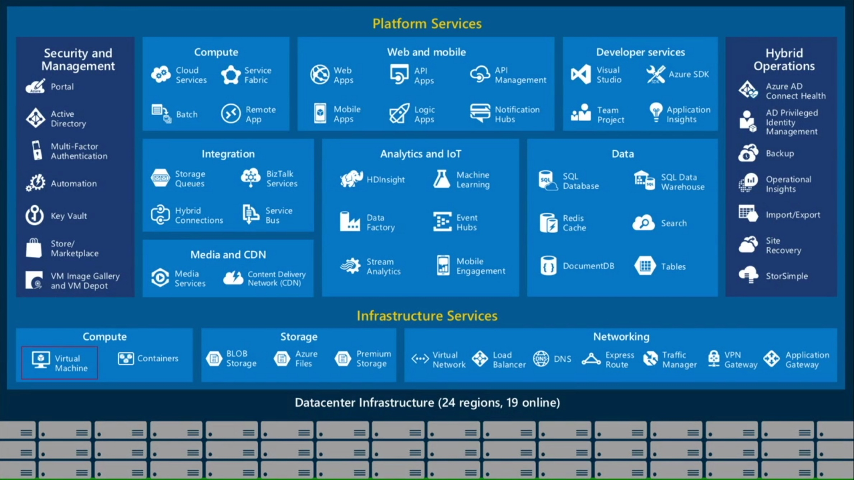
Bits of Azure

Slide 4
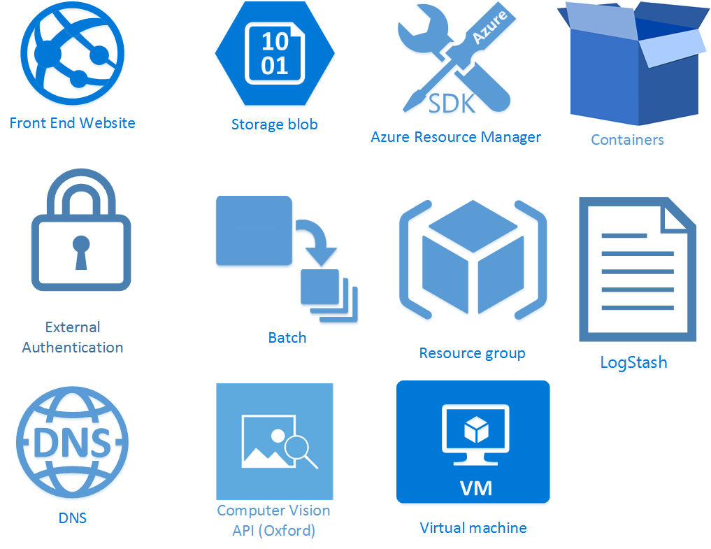

Slide 5
Questions? Drop us a line
@stimms
@canadianjames
BACKMATTER

